Slide 1
ReSTful Web Services
Dr. Abdul Razzaq
Abdul.Razzaq@ncirl.ie

Slide 2
Overview
JAXB annotations and integration into a RESTful web application
Exemplification: PlanetsApp RESTful web application
Binding Java objects into XML and JSON format representation
Sending XML and JSON format based objects
Introduction into POSTMAN: A tool for testing web application
Exemplification: How to test RESTful web application in Postman
BLOG RESTful Application – a complex RESTful application
Separation of Concerns Design principle
Part 1: implementation of GET messages/ message ID functionality

Slide 3
Java Architecture for XML Binding (JAXB)

Slide 4
JAXB
Java Architecture for XML Binding (JAXB) is a software framework that allows Java developers to map Java classes to XML representations.
JAXB provides two main features:
the ability to marshal Java objects into XML
and the inverse, i.e. to unmarshal XML back into Java objects.
In other words, JAXB allows storing and retrieving data in memory in any XML format, without the need to implement a specific set of XML loading and saving routines for the program's class structure.

Slide 5
JAXB - Annotation
When a top level class is annotated with the @XmlRootElement annotation, then its value is represented as XML element in an XML document.
import javax.xml.bind.annotation.XmlRootElement;
@XmlRootElement
public class MyPlanet {
public int id;
public String name;
public MyPlanet() {
public MyPlanet(int id, String name) {…}
... //get and set methods
}

Slide 6
JAXB - XML Output
XML representation of the planet resource specified in the Java class Planet.java
<myPlanet>
<id>1</id>
<name>Venus</name>
</myPlanet>
But how did we get this from our Java code?

Slide 7
JAXB - XML Output
JAX-RS annotated method
@GET
@Path("/planet")
@Produces(MediaType.APPLICATION_XML)
public Planet getPlanetXML(){
MyPlanet p = new MyPlanet();
p.id = 1;
p.name = “Venus";
return p;
}
This code produces XML format info in response to a GET request
We can see the method does not perform the conversion.
The conversion is automatically performed by the implementation of JAX-RS (i.e. Jersey)
We declare our intent to supply XML format via the @Produces annotation.

Slide 8
JAXB - XML Output
Returning a collection of planets
@GET
@Path("/planets")
@Produces(MediaType.APPLICATION_XML)
public ArrayList<MyPlanet> getPlanetsXML()
{
ArrayList<MyPlanet> list =new ArrayList<MyPlanet>();
MyPlanet p1 = new MyPlanet(1,"Earth");
list.add(p1);
MyPlanet p2 = new MyPlanet(2, "Mercury");
list.add(p2);
return list;
}

Slide 9
JAXB - XML Output
Returning a collection of planets…
Similar idea, returning a collection of planets, in this case an ArrayList of MyPlanet items.
Also note that we call an annotated method like getPlanetsXML() just
like a normal Java method, because
It is the framework which is adding special hooks to the method via the annotations. It can still be used without those.
Let's see the XML returned....

Slide 10
JAXB - XML Output
Collection of Planets returned in XML format
<myPlanets>
<myPlanet>
<id>1</id>
<name>Earth</name>
</myPlanet>
<myPlanet>
<id>2</id>
<name>Mercury</name>
</myPlanet>
</myPlanets>

Slide 11
Resources with Multiple Representations
HTTP Headers manage this negotiation
CONTENT-TYPE: specifies MIME type of message body
ACCEPT: comma delimited list of one or more MIME types the client would like to receive as a response
GET /customers/33323
ACCEPT: application/xml, application/json
Preferences are supported and defined by HTTP specification, by providing weights
GET /customers/33323
ACCEPT: text/html;q=1.0, application/json;q=0.5, application/xml;q=0.7
Default preference (text/html) has q = 1, followed by XML preference (q=0.7), then json ( q=0.5)

Slide 12
JABXB - JSON Output
Returning a collection of planets in JSON format
@GET
@Path("/planets")
@Produces(MediaType.APPLICATION_JSON)
public ArrayList<MyPlanet> getPlanetsJSON()
{
ArrayList<MyPlanet> list = new ArrayList<MyPlanet>();
MyPlanet p1 = new MyPlanet(1,"Earth");
list.add(p1);
MyPlanet p2 = new MyPlanet(2, "Mercury");
list.add(p2);
return list;
}
This method is the same as getPlanetsXML(), however it is annotated to produce JSON format representation of the collection of planets

Slide 13
JABXB - JSON Output
Collection of Planets returned in JSON format
[{"id":1,"name":"Earth"},{"id":2,"name":“Mercury"}]
So, how is this behaviour controlled?

Slide 14
JABXB - JSON Output
POM.xml must include entries for the dependencies needed
<dependency>
<groupId>org.glassfish.jersey.containers</groupId>
<artifactId>jersey-container-servlet</artifactId>
<version>2.32</version>
</dependency>
<dependency>
<groupId>org.glassfish.jersey.media</groupId>
<artifactId >jersey-media-json-jackson</artifactId>
<version>2.32</version>
</dependency>
<dependency>
<groupId>org.glassfish.jersey.media</groupId>
<artifactId>jersey-media-moxy</artifactId>
<version>2.32</version>
</dependency>

Slide 15
Accessing each Format
GET http://localhost:49000/api/myapp/planets
Accept: application/json
GET http://localhost:49000/api/myapp/planets
Accept: application/xml
GET http://localhost:49000/api/myapp/planets/{planetname}
Accept: application/xml

Slide 16
Exemplification of XML and JSON formats
PlanetsApp
A Web application that provides RESTful web services regarding planets
/planets resource -> provides a Java collection of MyPlanet type objects
/planets/{planetname} resource -> provides a MyPlanet java object
Both resources can return the info in XML and JSON format
PlanetsApp – consists of 2 java files
MyPlanet.java class – defines a MyPlanet type object
PlanetsService.java – implements the functionality behind the two resources

Slide 17
Exemplification of XML and JSON formats
PlanetsApp
In class TASKS
Download PlanetsApp.zip file and open the application in NetBeans
Examine the code of the application
Notice how we convert in XML or JSON representation MyPlanet object
Notice how we convert in XML or JSON representation an object that is a collection ArrayList of MyPlanet type items
Run and test the functionality of the two resources in a browser window
localhost:49000/api/planets/
localhost:49000/api/planets/Pluto
NOTE: Web browser permits only HTTP requests for information in XML format
To test JSON format we will use POSTMAN Tool.

Slide 18
6.9 POSTMAN Application

Slide 19
What is POSTMAN Application ?
Postman is a powerful HTTP client for testing web services.
One of the most popular tool used in API testing
Postman makes it easy to test, develop and document APIs
It allows users to quickly build both simple and complex HTTP requests

Slide 20
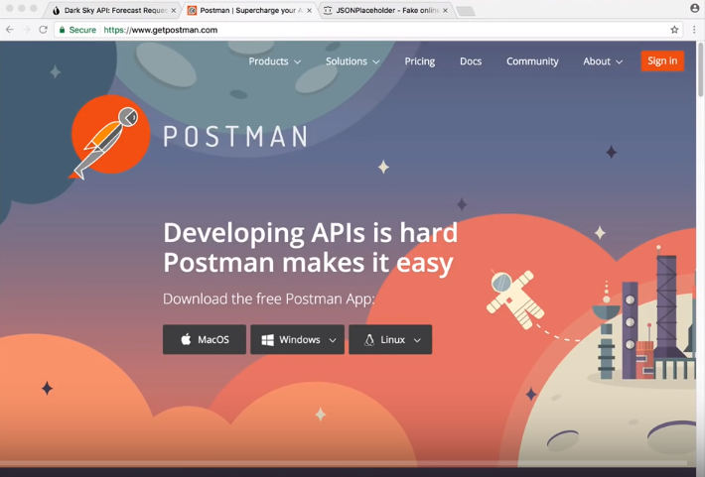
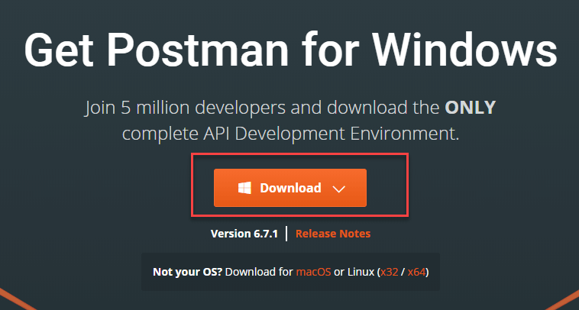
What is POSTMAN Application ?
Video: Introduction and Demo
https://www.youtube.com/watch?v=t5n07Ybz7yI
Download and Install Desktop version (version 8.12) : https://www.getpostman.com/downloads/
Need to create an account and apply upgrade to the latest version

Slide 21
POSTMAN Application
Exemplification how to use Postman to test PlanetsApp
Tasks for Lab session
Download and install Postman application ( have it ready before lab session!)
Use POSTMAN application to test the Web services you developed
Hello
Temperature Converter

Slide 22
Mock BLOG - A complex RESTful Application

Slide 23
A Mock BLOG RESTful Web Application
We are going to create a simple application to mock-up a BLOG that allows us to
Access one message or all messages already posted and stored in a simple memory-based data structure ( NO persistence Database is used)
Deliver the message(s) in XML or JSON format
Post new messages to the BLOG and store them in the memory data structure
The application will be designed and implemented over a number of stages take will be presented in the next lecture and lab sessions, over a couple of weeks
We will make use of Separation of Concerns (SoC) application design principle

Slide 24
Separation of Concerns (SoC)
Separation of concerns is a design principle for separating a computer program into distinct sections, such that each section addresses a separate concern
E.g., business logic of the application is a concern, user interface is another concern.
Changing the user interface should not require changes to business logic and vice versa
Advantages
Simplify development and maintenance of software applications.
Individual sections can be reused, as well as developed and updated independently.
Break program functionality into separate modules that overlap as little as possible.

Slide 25
BLOG Application – Design
Using the Design Principle of Separation of Concerns ( SoC ) we create 3 different packages for our application:
a Models package that will contain the POJO (Plain Old Java Objects) classes (e.g., message class)
a Services package that will contain the java class methods to hold the application functionality we want to provide through the REST API
a Resources package that will contain the java class methods that will bridge the URL resource mapping to service methods using the jersey specific annotations.

Slide 26
BLOG Application – Design
Separation of Concerns ( SoC ) design based BLOG Application will be implemented through a a number of steps
Description of the steps will be provided next
Implementation of these steps will be done in the lab session

Slide 27
BLOG Application – STEP 1
The resources are:
Collection of messages
a message instance ( e.g., message with id X)
We create MESSAGES related java classes (for the 3 different packages: models, services and resources) needed to have the RESTful API entry points to consume message resources via URL.
The following steps are common to the ones set for the Jersey Tutorial application.
Step 1
Using NetBeans create a new project, choose the Maven category and the project ‘Web application’.
Name the project (e.g., myblog) and select <No server selected> when prompted.

Slide 28
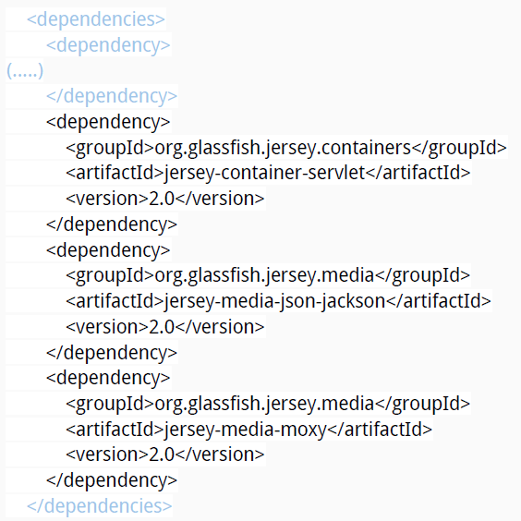
BLOG Application – STEP 2
Add the following Jersey dependencies to your Maven pom.xml file as child nodes of dependencies.

Slide 29
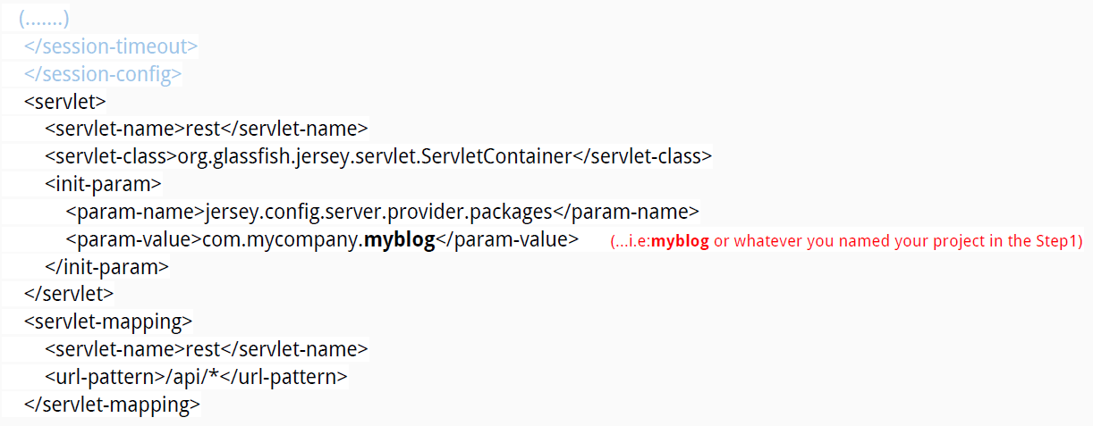
BLOG Application – STEP 3
Add the following into your web.xml file created in step 1.

Slide 30
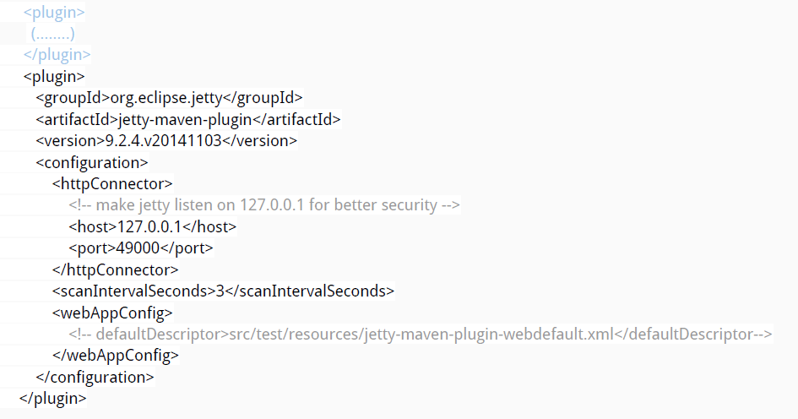
BLOG Application – STEP 4
Add the following plugin to the already existing list of plugins into your pom.xml.

Slide 31
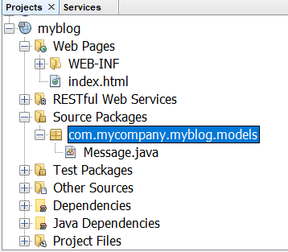
BLOG Application – STEP 5
We apply the software design principles of Separation of Concerns (SoC). Therefore, we create a new package called com.mycompany.myblog.models that will contain the Plain Old Java Objects (POJO) classes for our Blog.
Under this package we create a new class (Message.java) that defines the basic entities of our blog ( e.g. messages)

Slide 32
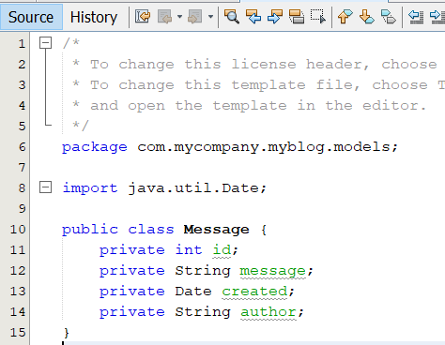
BLOG Application – STEP 6
Model the Java Message class to have the following fields:
ID to identify the message
Message which will contain the message text
Author indicating the author of the message
Created which will store the date when the message was created.
The Message format can be more complex. For this example, we keep it simple.
Need to code the Getters and Setters methods for all fields

Slide 33
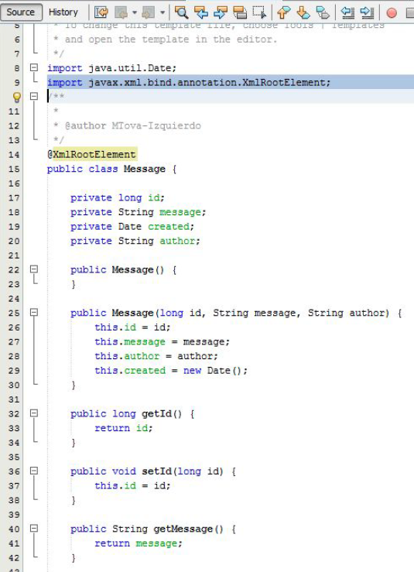
BLOG Application – STEP 6
The Message class should look like this:
(**Note) In order to return Message objects through our API in XML or JSON formats as part of our responses, we need to include a no-argument constructor in addition to the default constructor of the class.
We need as well to include the annotation @XmlRootElement at the top of the Message class to indicate the JAXB framework which that is used for marshall/unmarshall XML / JSON formats.
DO NOT FORGET to create both needed constructors.

Slide 34
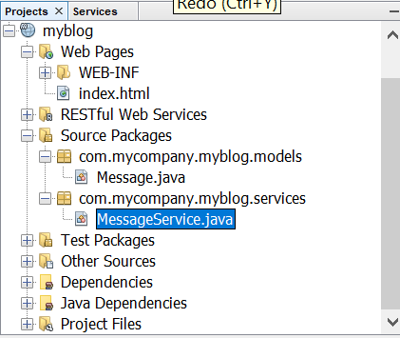
BLOG Application – STEP 7
In the same way we created the Models package in Step 5 as per the Separation of Concerns (SoC), we now need to create a new package called com.mycompany.myblog.services that will contain the Java classes defining the Services we want to be provided for our Model.
Under this package we then create a new class that defines our services for Messages. So, we create the MessageService java class.

Slide 35
BLOG Application – STEP 8
For this exercise we are NOT going to include a persistence layer (Database) to store our data. We will use a simple memory structure ArrayList to mock the Database layer.
The MessageService class will have two methods. We will include extra functionality later.
Include the memory based data structure:
public static List<Message> list = new ArrayList<>();
Include a method getAllMessages() that returns a list of all messages in memory
Method should look as shown in the image in the next slide.
Include a method getMessage(int id) that returns the message given the id passed as parameter.
Code is shown in the slide.

Slide 36
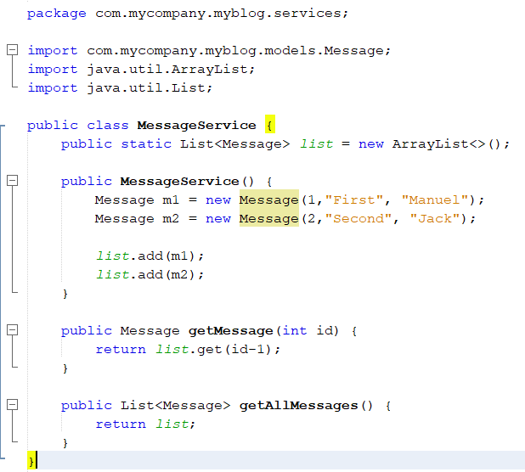
BLOG Application – STEP 8

Slide 37
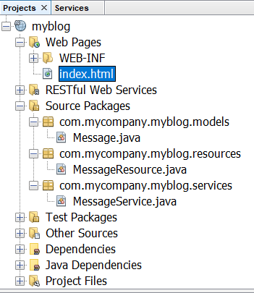
BLOG Application – STEP 9
In the same way we created the Models in Step 5 and the Services in Step 8 as per the Separation of Concerns (SoC), we now need to create a new package called com.mycompany.myblog.resources that will contain the Java classes defining the Resources handler we want to provide for our Blog API.
Under this package create a new class that defines the resources to be exposed. So, create the MessageResource java class.

Slide 38
BLOG Application – STEP 10
For now, we will include the API entry points only for retrieving/getting (@GET verb) ALL messages in the list and ONE message by ID.
We will reply to the responses in two formats: XML and JSON.
The MessageResource class will have four methods as follows:
getMessagesXML() will return ALL messages for a GET request and build the response in XML format
getMessagesJSON() will return ALL messages for a GET request and build the response in JSON format
getMessageXML() which returns the message given the ID passed parameter and build a response in XML.
getMessageJSON() which returns the message given the ID passed as parameter and build a response in JSON.

Slide 39
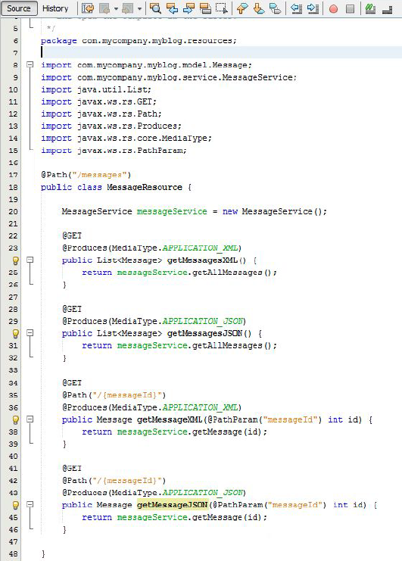
BLOG Application – STEP 10
The MessageResource class should look as shown in the image.

Slide 40
BLOG Application – STEP 11
Right click on the NetBeans project, select properties, move to the actions tab.
If Using Jetty Server: Select the run project action, change the execute goals to jetty:run

Slide 41
BLOG Application – STEP 12
Build and run...
You can test the app in a internet browser or using Postman application E.g. this URL localhost:49000(8080)/api/messages tests for example running and returning the full list of messages in XML format.
If using Postman, in the Headers menu option, set Accept value as application/xml to get the response in XML format
You can try localhost:49000/api/messages/1 to see the application running and returning a message by the id=’1’ in XML format.
To retrieve the messages list or a message by id in JSON format use the postman app
in the Headers menu option Set Accept value as application/JSON to get the response in JSON format

Slide 42
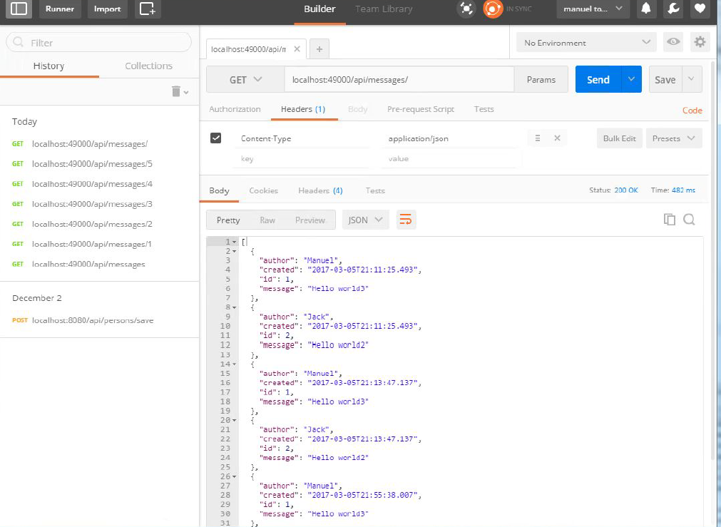
BLOG Application Testing: POSTMAN App

Slide 43
BLOG Application – LAB Task
Develop step by step ( STEP 5 –> STEP 12) the BLOG Application
Skeleton Blog App with implementation for STEP 1-> 4 is provided
Follow the tasks description provided in the lecture notes

